Slide 1

DEPARTMENT OF CSE (ARTIFICIAL INTELLIGENCE AND MACHINE LEARNING) ACADEMIC YEAR 2025 - 2026 SEMESTER III ARTIFICIAL INTELLIGENCE LABORATORY MINI PROJECT REVIEW PATHFINDING FOR PAC-MAN USING GREEDY BEST FIRST SEARCH
REGISTER NUMBER | 2117240030032
NAME | GANGAVARAM BHAVITHA
YEAR | II
SECTION | A
FACULTY IN-CHARGE | Mrs. M. Divya

Slide 2
PROBLEM STATEMENT
Artificial Intelligence (AI) enables machines to make intelligent decisions and perform goal-oriented actions based on environmental data.
Pathfinding is a core AI application that focuses on finding the most efficient path between two points in a given environment or maze.
This project deals with pathfinding for Pac-Man, where the aim is to guide Pac-Man from a starting position to a goal (food) while avoiding walls and obstacles.
The Greedy Best First Search (GBFS) algorithm is used to determine the path based on heuristic reasoning, allowing Pac-Man to move intelligently toward the goal.
GBFS uses the Manhattan distance heuristic to estimate the cost from the current position to the goal and selects the node that appears closest to the target.
The algorithm makes decisions under uncertainty by exploring the most promising nodes first, reducing search time and improving efficiency.
The maze environment is represented as a grid, consisting of cells denoting open paths, walls, start, and goal positions.
A Tkinter-based graphical visualization is implemented to display Pac-Man’s movement step by step, showing how the algorithm explores and reaches the goal.
The project emphasizes the importance of heuristic-based AI techniques in solving real-time pathfinding and navigation problems.

Slide 3
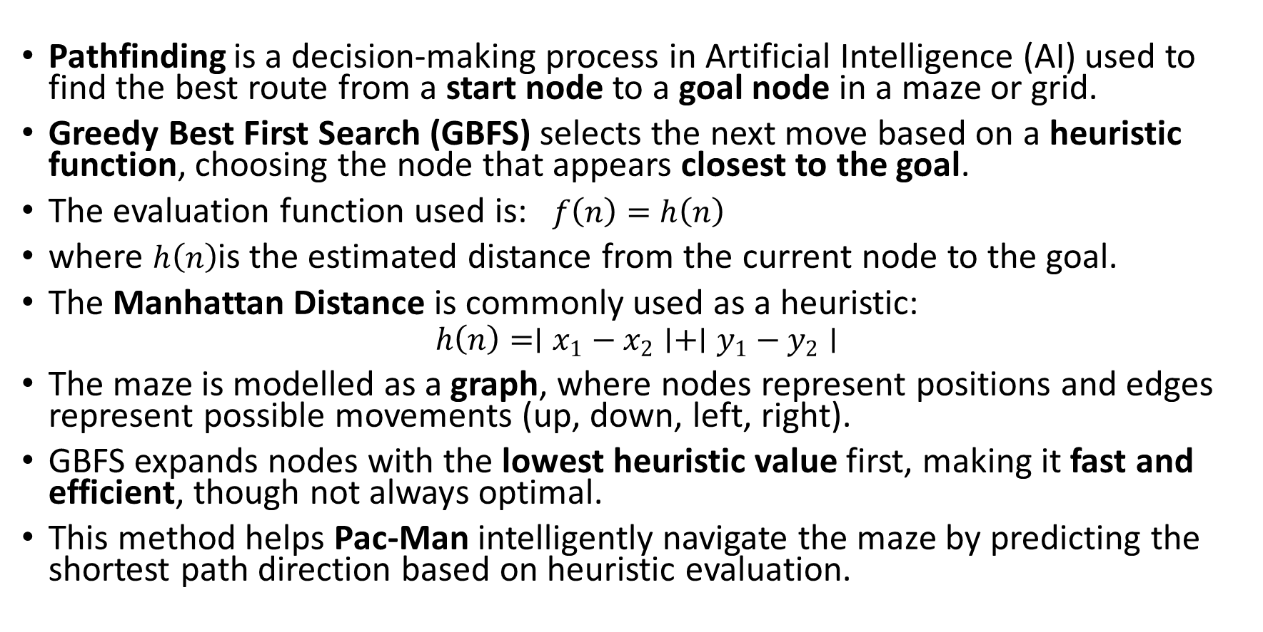
THEORETICAL BACKGROUND
Pathfinding is a decision-making process in Artificial Intelligence (AI) used to find the best route from a start node to a goal node in a maze or grid.
Greedy Best First Search (GBFS) selects the next move based on a heuristic function, choosing the node that appears closest to the goal.
The evaluation function used is: $f\left(n\right)=h\left(n\right)$
where $h\left(n\right)$is the estimated distance from the current node to the goal.
The Manhattan Distance is commonly used as a heuristic:
$$h\left(n\right)=∣x_{1}−x_{2}∣+∣y_{1}−y_{2}∣$$
The maze is modelled as a graph, where nodes represent positions and edges represent possible movements (up, down, left, right).
GBFS expands nodes with the lowest heuristic value first, making it fast and efficient, though not always optimal.
This method helps Pac-Man intelligently navigate the maze by predicting the shortest path direction based on heuristic evaluation.

Slide 4
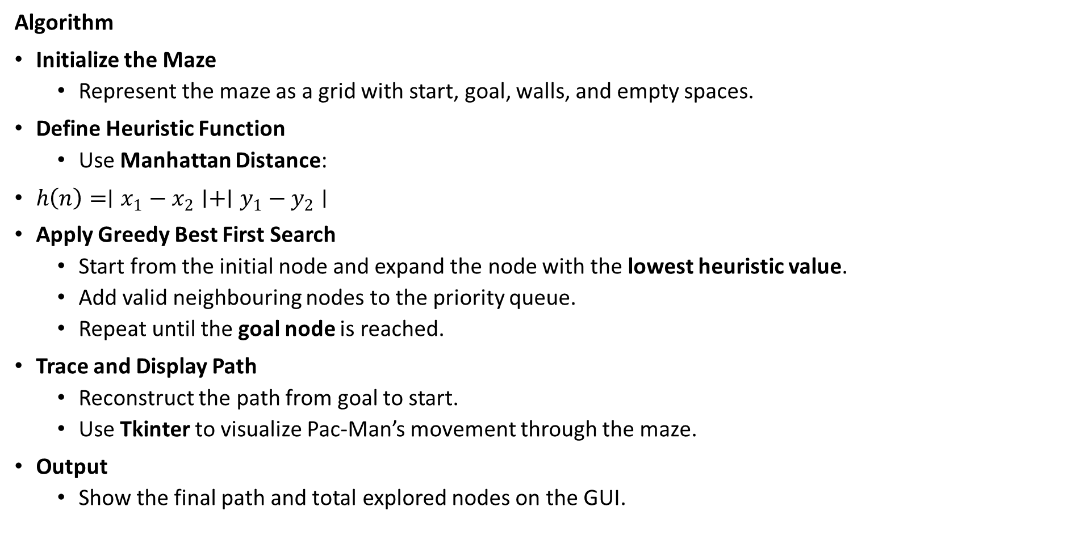
THEORETICAL BACKGROUND
Algorithm
Initialize the Maze
Represent the maze as a grid with start, goal, walls, and empty spaces.
Define Heuristic Function
Use Manhattan Distance:
$h\left(n\right)=∣x_{1}−x_{2}∣+∣y_{1}−y_{2}∣$
Apply Greedy Best First Search
Start from the initial node and expand the node with the lowest heuristic value.
Add valid neighbouring nodes to the priority queue.
Repeat until the goal node is reached.
Trace and Display Path
Reconstruct the path from goal to start.
Use Tkinter to visualize Pac-Man’s movement through the maze.
Output
Show the final path and total explored nodes on the GUI.

Slide 5
IMPLEMENTATION AND CODE
Link to code in Git-hub Repository
List | Git-hub Repository Links
Implementation of Code Link | https://github.com/bhavitha2806/Bhavitha-G/blob/main/pathfinding.py

Slide 6
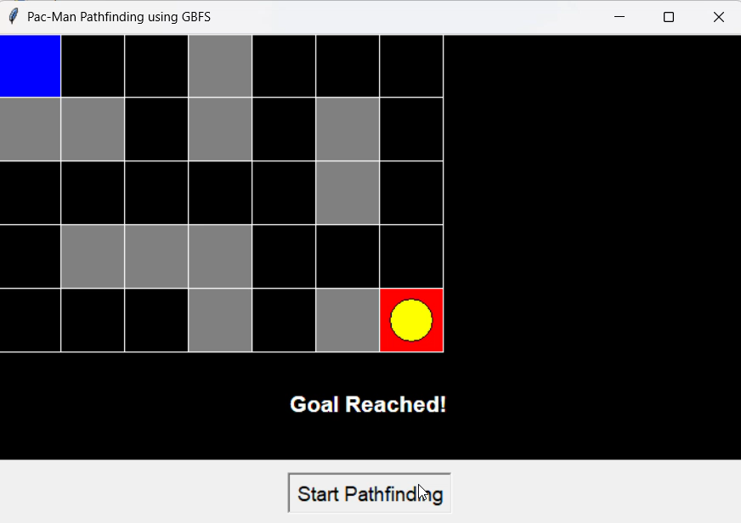
OUTPUT AND RESULTS
The output displays a maze interface using Tkinter, where Pac-Man starts from the initial position and moves toward the goal using the Greedy Best First Search algorithm.
During execution, the GUI visually shows Pac-Man’s path exploration step by step, highlighting visited cells and the final optimal path.
Once the goal is reached, the final path is marked, and the total number of explored nodes is displayed.
This demonstrates how the GBFS algorithm finds a fast, heuristic-based path to reach the target efficiently.

Slide 7
OUTPUT AND RESULTS
Results
The Greedy Best First Search (GBFS) algorithm successfully finds a valid path for Pac-Man from the start position to the goal in the maze.
The system efficiently explores the maze using the Manhattan distance heuristic, selecting the node closest to the goal at each step.
The Tkinter visualization clearly shows Pac-Man’s movement, visited nodes, and the final shortest path to the goal.
The algorithm demonstrates fast performance in reaching the target but may not always find the most optimal path compared to A* Search.
Overall, the project effectively shows how heuristic-based AI search can be used for intelligent and visually interpretable pathfinding.

Slide 8
OUTPUT AND RESULTS
Future Enhancements
Integrate dynamic obstacles and enemies (ghosts) to simulate a more realistic Pac-Man environment.
Implement multiple search algorithms (like A*, Dijkstra, and BFS) to compare performance and path optimality.
Add real-time movement animation and sound effects for an interactive user experience.
Extend the system to support multiple goals or collectibles instead of a single target.
Develop an AI-controlled Pac-Man that adapts its strategy based on maze complexity and previous runs.
Create a web or mobile version of the game using Python frameworks for accessibility and user engagement.

Slide 9
REFERENCES
References
Russell, S., & Norvig, P. (2020). Artificial Intelligence: A Modern Approach (4th Edition). Pearson. https://aima.cs.berkeley.edu/
GeeksforGeeks – Greedy Best First Search Algorithm in AI. https://www.geeksforgeeks.org/greedy-best-first-search-algorithm/
TutorialsPoint – Artificial Intelligence – Search Algorithms. https://www.tutorialspoint.com/artificial_intelligence/artificial_intelligence_search_algorithms.htm
Towards Data Science – Understanding Informed Search Algorithms (GBFS & A*). https://towardsdatascience.com/
Python Official Documentation – Tkinter Graphical User Interface (GUI). https://docs.python.org/3/library/tkinter.html
Python Official Documentation – Heapq and Priority Queue Implementation. https://docs.python.org/3/library/heapq.html

